Slide 1



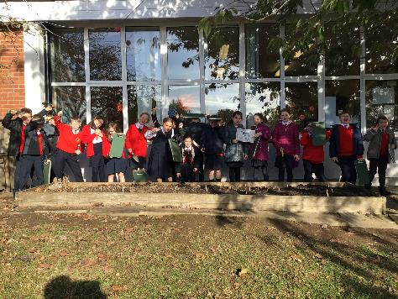
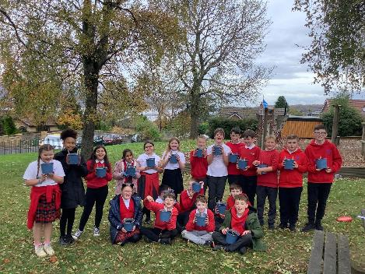
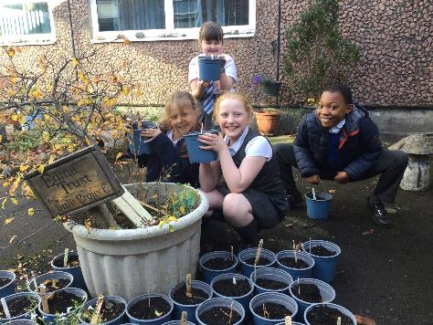
Results Report
2026

Slide 2


The Edina Trust would like to thank everyone who worked so hard planting their bulbs, observing, and sending in their records.
We couldn’t have carried out an experiment like this without your help!
You are all SUPER!
And now for the results…
Look out for questions along the way!
?

Slide 3
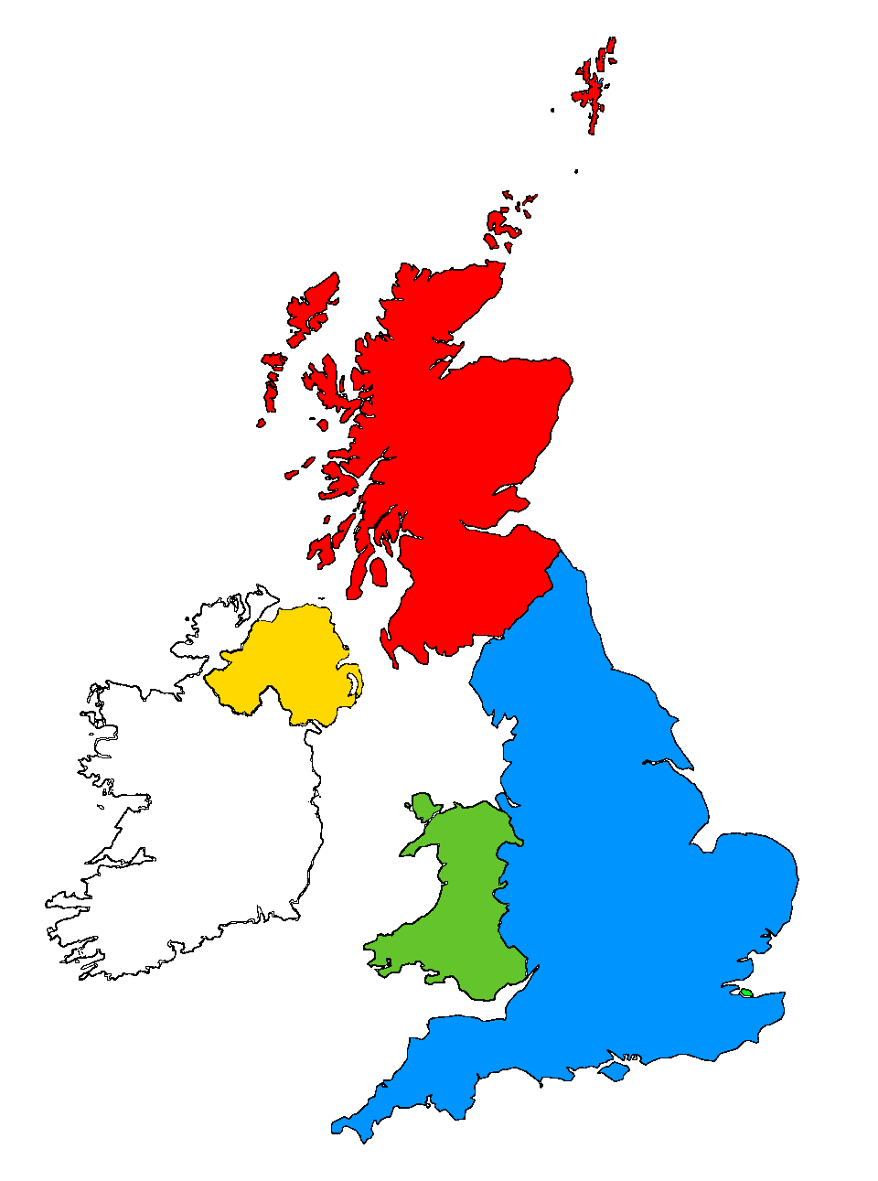
For this investigation we divided all schools into the four countries taking part:
Scotland
Northern Ireland
England
Wales

Slide 4


?
Which country had the most rain?
189mm
During the Bulb Project, Wales had an average of 76mm more rain than England.
135mm
122mm
113mm
Wales had the most rain during the project this year.
Can you estimate how much more rainfall there was in Wales compared to England?
?

Slide 5


?
Which country was the warmest/coldest?
Scotland is further north (it has a higher latitude). Places further from the equator do not have as much direct sunlight so it is normally colder.
Click here to watch the animation!
or click outside this box to skip
Wales was warmest this time, and Scotland was the coldest
?
Why do you think Scotland was colder than the rest of the UK?

Slide 7

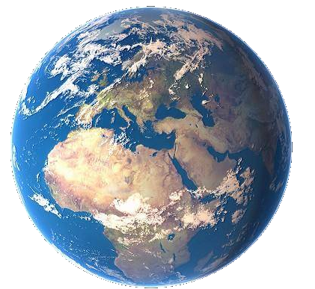
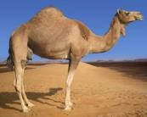

As the sunlight is shining on the Earth…
UK
This makes it warm at the equator and cold at the North and South Pole!
Equator
…the same amount of light and warmth is spread across more of the surface than at the equator.
Click here to replay!
or click outside this box to move on.

Slide 8

Which country was the coldest
in December?
?
Northern Ireland was the coldest country in December.

Slide 9
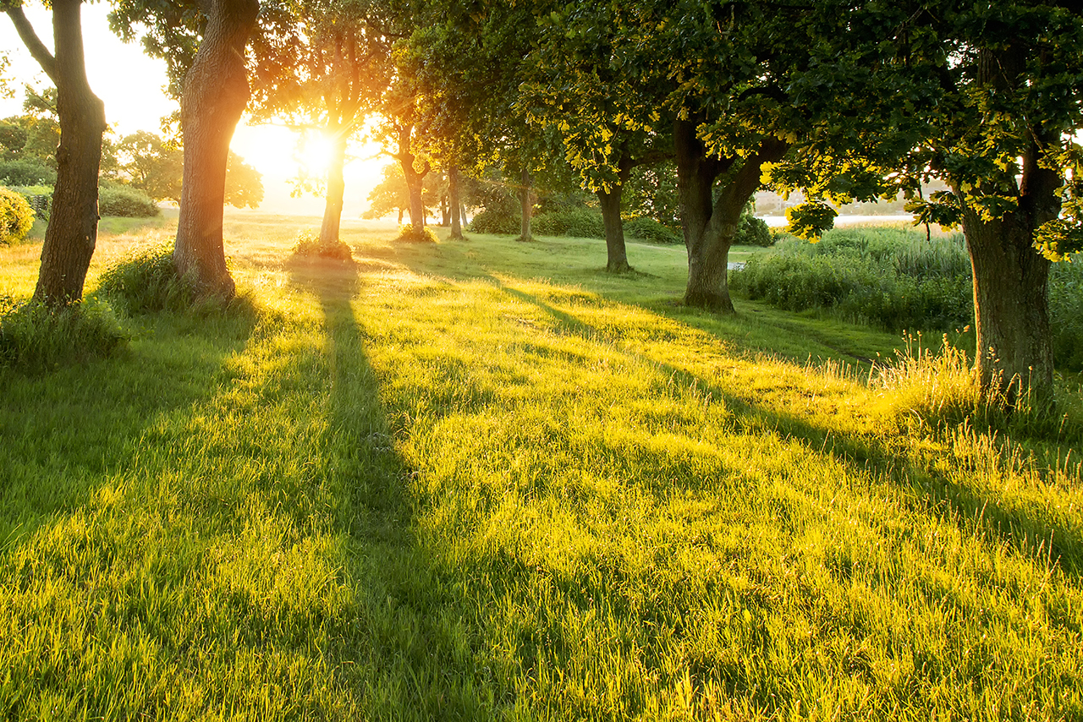
Which country was the warmest
in March?
?
Wales was the warmest country in March.

Slide 10
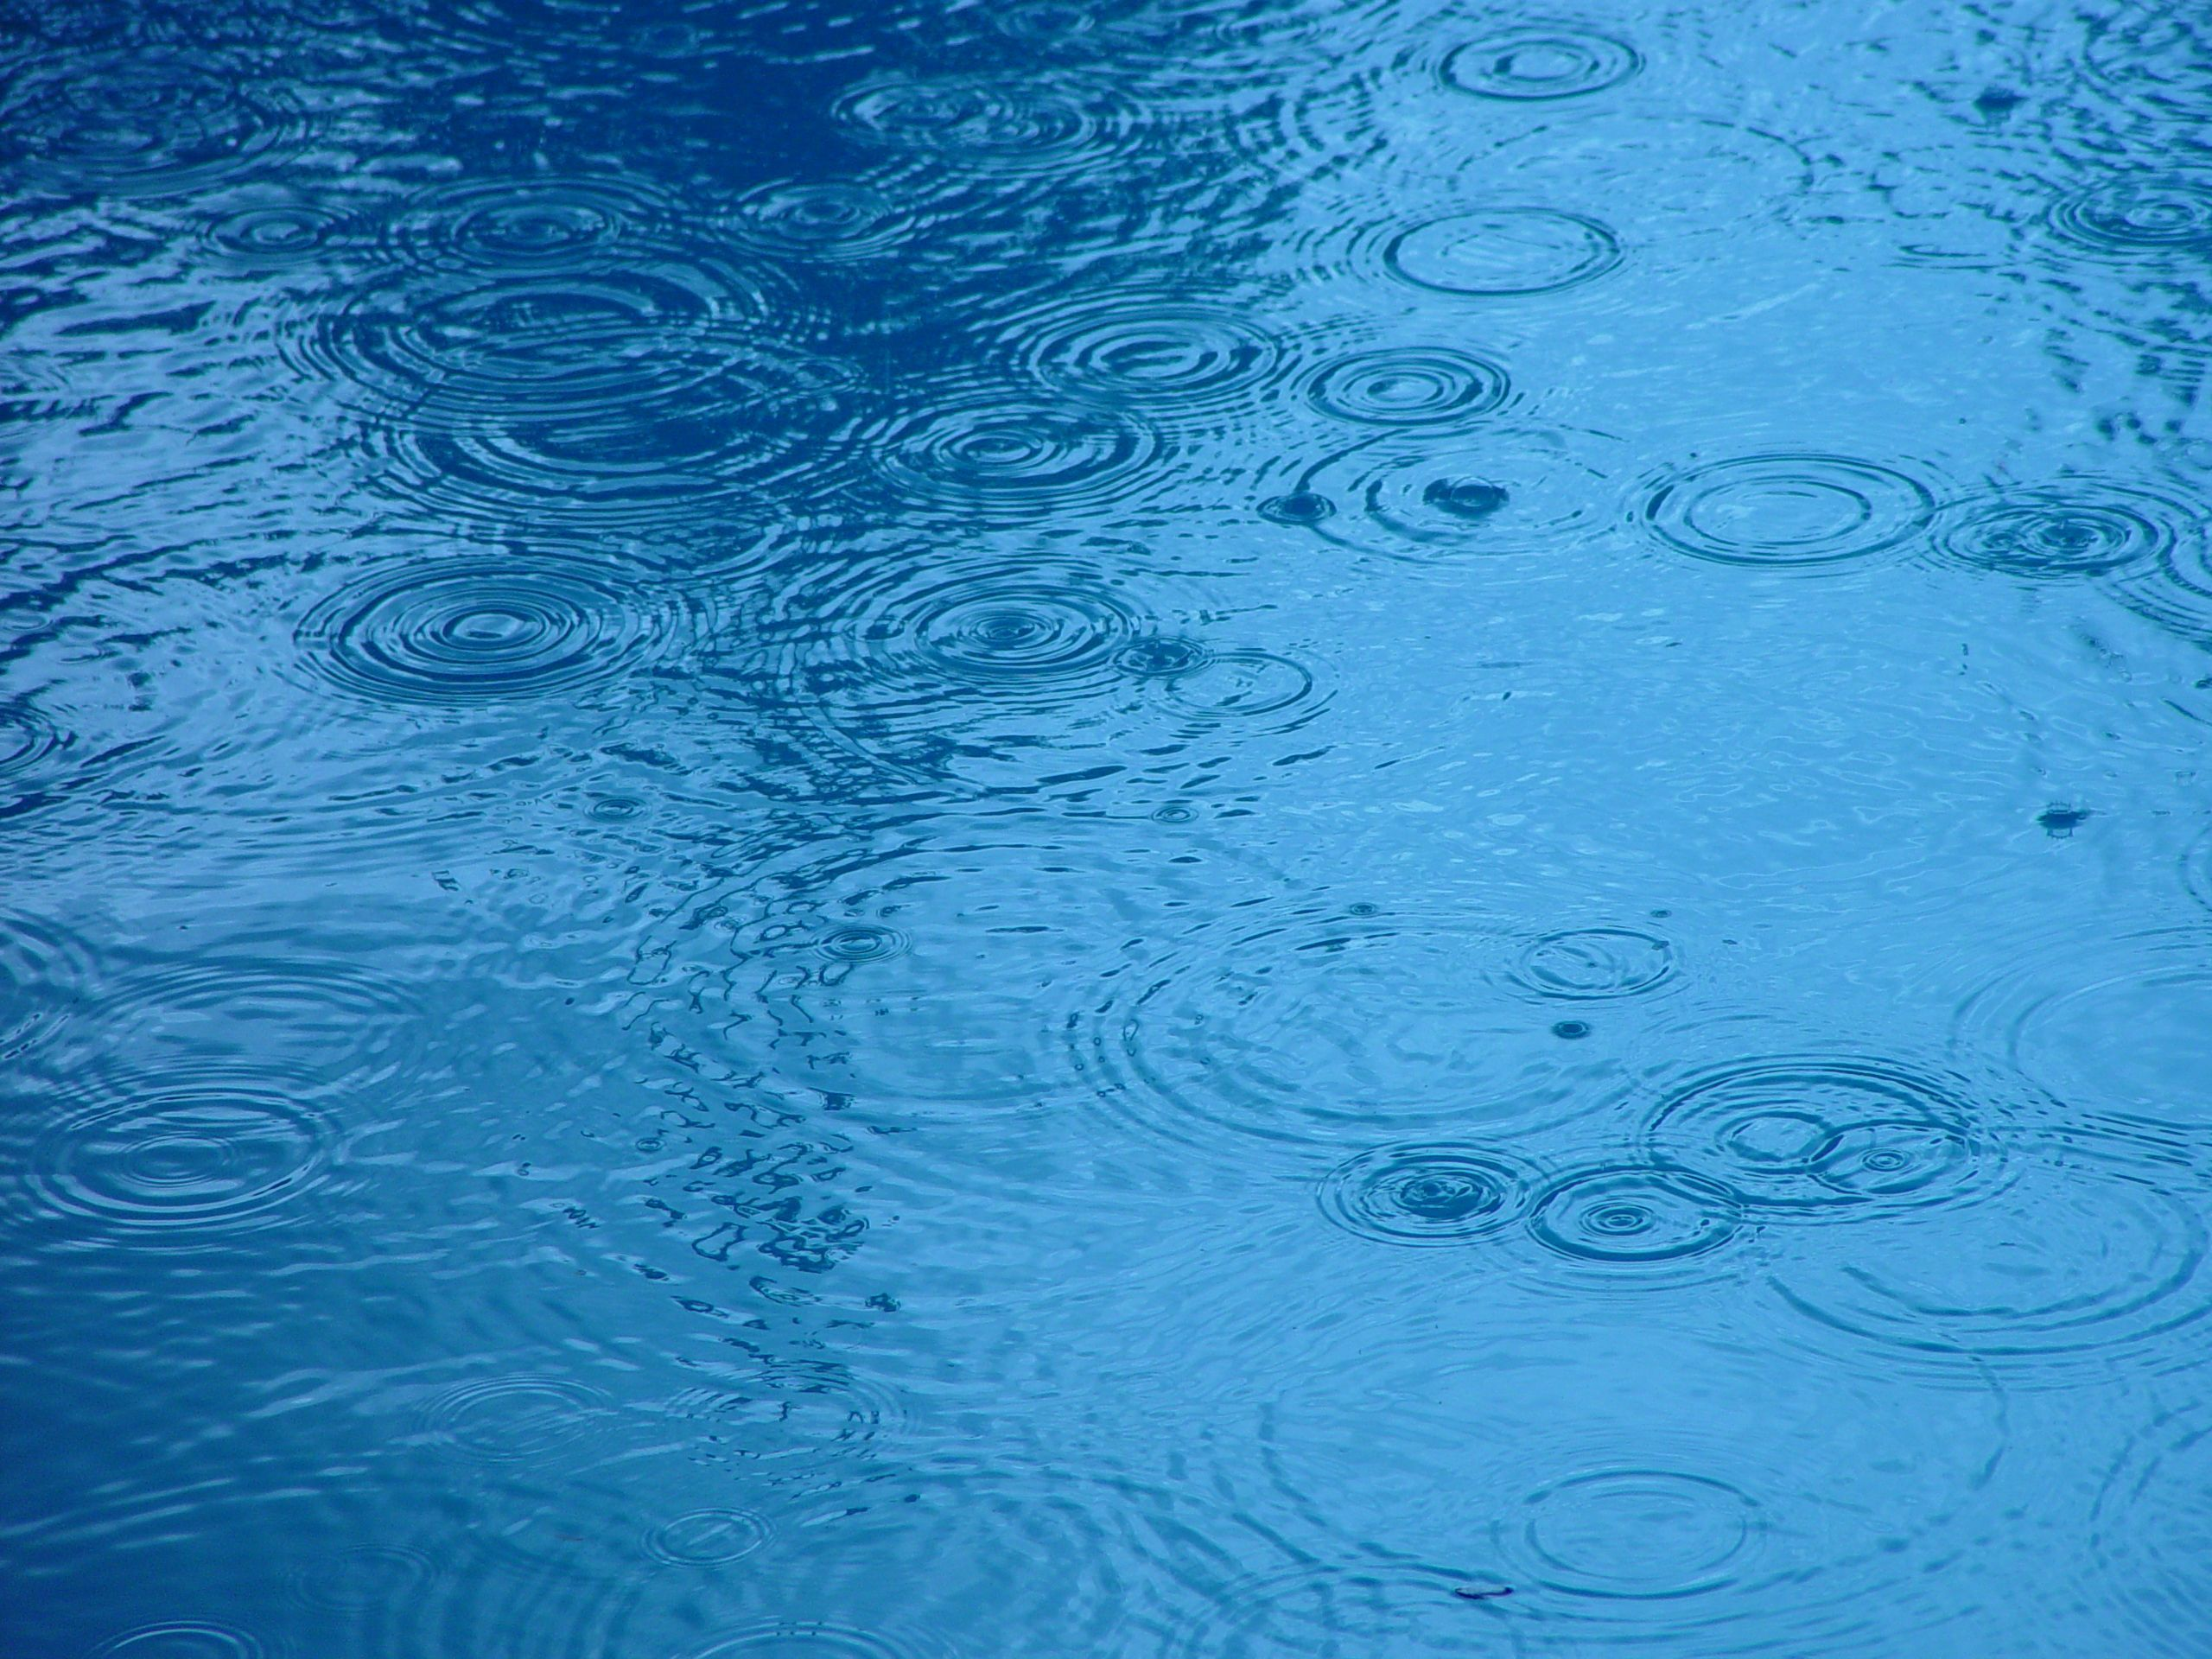

?
Considering what we know so far, where do you think daffodils flowered first?
2025/26 Weather Data from Schools
Most Rain: Wales N Ireland and Scotland were in the middle. England was the driest. | Warmest: Wales England and N Ireland were in the middle. Scotland was the coldest.

Slide 11





?
Where did the first daffodils flower?
1. Wales – 2nd March
4
14
5
15
13
8
6
7
1
9
3
12
2
16
10
11
2. England – 8th March
Plants require water and warm sunlight to grow.
However they can sometimes have too much water or sun, and other factors can affect the flowering date too.
3. N. Ireland – 9th March
Click to start the animation and find out!
4. Scotland – 16th March
March
Note: These include the dates for bulbs in pots AND bulbs in the ground.
March
March
March
March
March
March
March
March
March
March
March
March
March
March
March
Daffodils flowered first in Wales this year!
Were you correct? Why do you think that is?
?

Slide 12

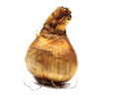
Our hypothesis for the Bulb Project is that daffodils in pots will flower before those in the ground.
We think this is because bulbs in the ground are more insulated, so they do not “feel” the changes in temperature as much.
The weather is warming up today!
Let’s find out what happened, using the data sent by our Super Scientists… (You!)
I wonder if it’s spring up there yet?

Slide 13





How many days difference was there between the daffodil flowering dates?
?
= bulbs planted in the ground
= bulbs planted in pots
?
?
?
6
8
England
1
day(s) difference
Scotland
N. Ireland
March
M | T | W | T | F | S | S
 |  |  |  | 1 | 2 | 3
4 | 5 | 6 | 7 | 8 | 9 | 10
11 | 12 | 13 | 14 | 15 | 16 | 17
18 | 19 | 20 | 21 | 22 | 23 | 24
25 | 26 | 27 | 28 | 29 | 30 | 31
Average Flowering Date for Each Country

Slide 14
Here are the average flowering dates across the whole of the UK compared to last year:
 | 2025 | 2026
Daffodils in Pots | 6th March | 9th March
Daffodils in the Ground | 8th March | 11th March
The average flowering date for bulbs in pots was earlier, both in 2025 and 2026.
In both cases, bulbs in the ground flowered 3 days later, on average.

Slide 15
Our hypothesis was not supported by the data this year. Daffodils planted in pots flowered first, but the difference was only 3 days.
The difference is so small that we can say it is ‘not significant’.

Slide 16
Here are the average flowering dates across the whole of the UK since 2021/22.
2021/22 | 2022/23 | 2023/24 | 2024/25 | 2025/26
8th March | 19th March | 4th March | 7th March | 9th March
Let’s compare these results with the weather recordings...
Here’s the average temperature from the Bulb Project each year across the UK.
?
Do you think this data shows that the temperature affected the flowering date?

Slide 17
Here are the average flowering dates across the whole of the UK since 2021/22.
2021/22 | 2022/23 | 2023/24 | 2024/25 | 2025/26
8th March | 19th March | 4th March | 7th March | 9th March
This time it’s the average rainfall from the Bulb Project each year across the UK.
?
Do you think this data shows that the amount of rain affected the flowering date?

Slide 18
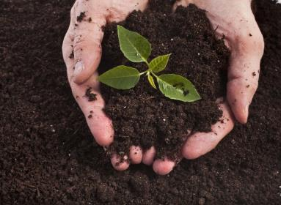
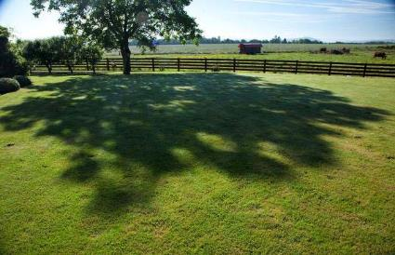
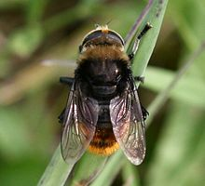
?
Do you think there could be other reasons for bulbs to flower earlier or later?
I’m not a bee! I’m a Narcissus Fly and I eat daffodil bulbs. I look like a bee so that other animals think I can sting!
Here are some ideas of things that might affect daffodil flowering dates…
Soil quality
Shade
Pests & diseases
?
What changes could you make to the Bulb Project to test these ideas?

Slide 19
Which country had the tallest/shortest daffodils?
?
26cm
26cm
25cm
6cm difference
20cm
Consider what daffodils and other plants need to grow.
?
Using the bar chart can you work out how tall the daffodils are?
How much taller were daffodils in Wales and England compared to Scotland?
Why do you think the daffodils grew the tallest in Wales and England?

Slide 20

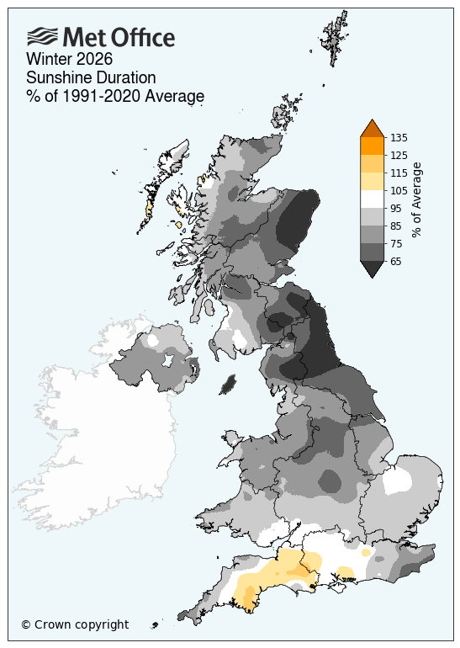
Here’s a map from the Met Office showing the amount of sunshine in December, January, and February.
This isn’t something we can measure as part of the project - unless you were at school all day, every day!
Yellow/orange = more sunny days
Grey = fewer sunny days
?
What can you notice about the amount of sunshine in different areas?
?
Do you think the amount of sunshine can affect the growth of your bulbs?
Check out the Met Office report 

Slide 21
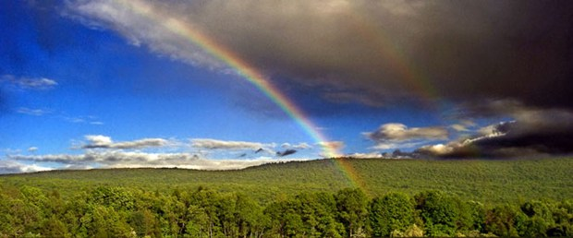
Finding a trend is quite difficult but some things are clear…
The bulbs rely on both warm sunshine and water in order to flower.
Our seasons are becoming more unpredictable as our world is getting warmer.
How do you think this might affect the growth of plants in the future?
?

Slide 22


Thank you for taking part!
Now try our
challenges!
Level 1: We recommend this version for our younger Super Scientists. It is shorter and has simpler questions. Take a look at the graphs and think about why bulbs flowered at different times in different places.
GO!
Level 2: This challenge looks at the charts in more detail and asks pupils to consider how the temperature and rainfall in different areas of the UK, and throughout the last four years of the project, could affect the flowering dates.
GO!
These challenges could be played through together as a class or for individual pupils.

